Slide 1

6CS007 – Project and Professionalism
Literature Reviews
Notes:
Last updated: 17/01/17.

Slide 2
Learning Outcomes
By the end of this session, you will be able to:
appraise what is a literature review?
appraise the structure of a literature review.
appraise how to write a literature review.

Slide 3
Introduction
Finding Academic Information
Harvard Referencing
Literature
Review

Slide 4
What is a Literature Review?
A comprehensive review of the literature available for any given research area or question.
It is a summary, analysis and critical evaluation of that literature.
An explanation of what research has already been performed in that area.
“It is used to determine what is known on a topic, how well this knowledge is established and where future research might best be directed”*.
* https://students.unimelb.edu.au/academic-skills/resources/report-writing/reviewing-the-literature

Slide 5
What is a Literature Review?
Note, you would not highlight elements in your document / a section of a report like this.
It is a document or section in report that explores and evaluates the literature on a specific topics or question.
So, what would a document look like?
Example.
“Virtual reality interaction approaches have undergone significant research in recent years (Hannema, 2001; Park, et al., 2017; Breslauer, et al., 2019). Research into optical trackers has seen significant success due their more direct and intuitive interaction leveraging real-world experience (Rautaray & Agrawal, 2015; Anthes, et al., 2016). However, as previously discussed in Chapter 1, section 1.4, optical trackers have four key issues: field-of-view, occlusion, accuracy and stability. In order to investigate this area, current interaction approaches should be established, and their respective hand-based research discussed.”
Source: A Multiple Optical Tracking Based Approach for Enhancing Hand-Based Interaction in Virtual Reality Simulations – Adam Worrallo.

Slide 6
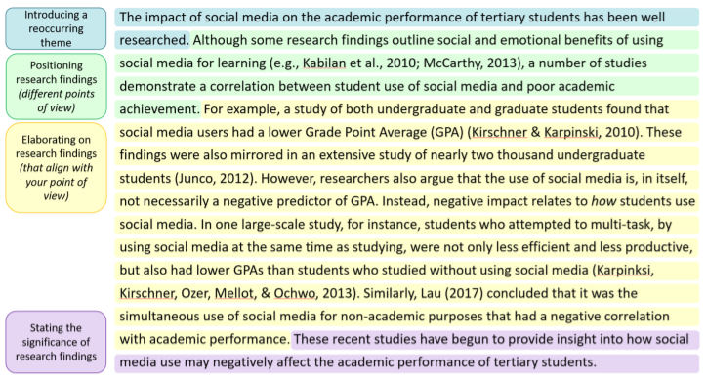
What is a Literature Review?
It is a document or section in report that explores and evaluates the literature on a specific topics or question.
So, what would a document look like?
Another example.
Note, you would not highlight elements in your document / a section of a report like this.
Source: https://www.scrintal.com/guides/how-to-write-a-literature-review.

Slide 7
Why do a Literature Review?
Enables you to collect, study, compare and evaluate current knowledge and research in an area / field of study*.
A way for you to study and disseminate your knowledge in an area / field.
Learn about and show what research has already been done on any given subject.
You may also be able to highlight areas which relate to the subject in hand but may not have had as much research carried out upon them.
For larger projects (e.g., your final year dissertation) they are good starting points.
You learn the background / context in an area / field. You learn what has been done.
Then you can use this knowledge to do something – develop an idea, develop a new algorithm or piece of software.
* https://www.durham.ac.uk/media/durham-university/departments-/common-awards/documents/assessment-documents/guidance-documents/Assessment-Guidelines_Literature-Reviews.pdf

Slide 8


Why do a Literature Review?
Example:
I have a project where I want to use Minecraft to teach people.
Therefore, I want to find out how Minecraft can be used to teach people.
I want to find what has been done already.
Why:
To understand what has and can be done.
Reason: Disseminate information - Company speculation, write a blog, academic (show you understanding in an area).
Output: Write a report.
To understand what has and can be done, then create a new Minecraft education application. Typically, I would then also test my new app to see if what has been created is any good.
Reason: Create something new (that has not been done before) – new company product/area, academic (final year project).
Output: New software/algorithm and a report.
Source: https://education.minecraft.net/en-us/lessons/frozen-planet-ii-frozen-worlds
To create something new we need to know what has been done before!

Slide 9
When do a Literature Review?
Can be stand-alone project or part of larger project like a dissertation.
Often started before research question posed and proposal submitted.
Then carried on as first step in project.
Can be all done before research question posed.
Ongoing project alongside research.

Slide 10
Types of Literature Review
Narrative Review:
Comprehensive but does not follow, or make explicit, rules that were used to search for information or the decisions that the author made on the relevance or validity behind included sources.
Systematic Review:
Follows, and clearly states, defined rules to search for, analyse and synthesize relevant studies. Involves development of a search strategy and inclusion and exclusion criteria in order to determine what should be included in the review. A meta-analysis or meta-ethnography is then conducted to combine the sources and form new conclusions.

Slide 11
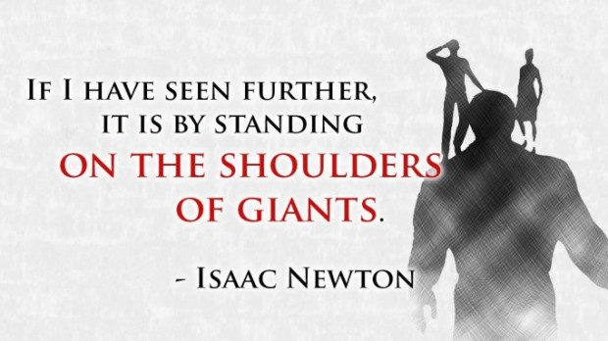
What is included?
Image source: https://3starlearningexperiences.wordpress.com/2018/12/24/standing-on-the-shoulders-of-giants-an-offer-you-cant-refuse/
Historical background for research.
Current / recent research context for your research area.
Questions, issues, debates, significance of the issue being researched.
Show related work.
Limitations.
The literature review is evidence of what works and does not work in an area.
Relevant theories and concepts.
Disagreements; controversy; alternative perspectives
Identify key papers and thinkers.
Definition of relevant terms.
Potential gaps in literature.
Calls for further research relevant to your topic.

Slide 12
General Structure of a Literature Review
Introduction.
This is a brief description of your research area.
It gives you the opportunity to define it, highlighting any areas that you have excluded, and the reasons for doing so.
Also allows you to explain the organisation and sequence of your review for the reader.
Main Sections.
It should show how your work (e.g., question, aims) relates to existing literature, make connections.
Make sure that the main body of the review has a coherent flow so that the reader can follow your argument.
Thing to include:
Key studies/major thinkers
Areas of disagreement.
Compare/contrast different authors.
Remember to write in the third-person.

Slide 13
General Structure of a Literature Review
Main Sections (continued).
A key task is identifying ideas / topics / areas from the initial research for sub-sections.
You should do this by looking at your initial research and identifying ideas / topics / areas that you think should be included.
Example:
Literature review subject:
Literature Review of Games Technology and Autonomous Cars.
Ideas / topics / areas that could be found:
Simulating environments.
Simulating Autonomous vehicles.
Simulating Crowds.
Sensor models, such as camera, infrared (IR) camera and LiDAR.
Simulating weather.

Slide 14
General Structure of a Literature Review
Main Sections (continued).
Another Example:
Literature review subject:
Literature Review of Game-Based Learning Using Minecraft.
Ideas / topics / areas that could be found:
Learning.
Serious Games.
Digital Game-Based Learning.
Minecraft EDU.
Conclusion.
Summarise the existing literature as covered by your review.
A section at the end of a literature review chapter in your dissertation.
If part of a bigger report…
Identify how your work will build upon and add to this literature or how it will address the gaps or issues that exist in it.

Slide 15
Also Think about Paragraph Structure
A key thing to think about when writing is your paragraph structure.
For example:
“Attending study skills workshops is vitally important for university students.
Topic sentence.
Jones (2008) reported that study skills teaching can help students to improve their assignments. This was supported by Tudor (2009) who found that study skill workshop attendance was associated with higher degree class.
Supporting sentence.
Together, this would suggest that participation in core skills development training can influence student success.”
Concluding sentence.
Introduce a theme / topic.
Position research findings.
Elaborate (example of research, what did and found, etc).
State significance of research findings.

Slide 16
Your Line of Argument
Make sure your line of argument is easy to follow – start a new paragraph with each new idea you introduce.
Signpost to your reader where the discussion is going. If you are building on an idea, make this clear (‘Moreover…’ / ‘In addition…’ / ‘Furthermore…’ etc.)
Equally, if you are introducing a conflicting line of argument make this clear (‘However…’ / ‘Conversely…’ / ‘In contrast to this…’)

Slide 17
Critical Writing
Critical thinking does not apply only to what you read.
When writing, try to be more analytical than descriptive.
Be clear and concise.
Provide evidence and reasoning.
You can (and should) provide your own ideas in your discussion, but back these up with reference to sources.

Slide 18
Showing Analysis and Understanding
Comparing:
Hopkins (2012), in agreement with Cowell (2009), posits that a minimum alcohol pricing policy would have a significant impact on the health of the UK population.
Contrasting:
Morris (2010), in direct opposition to White’s (2009) theory, argues that a minimum alcohol pricing policy would primarily penalise working class drinkers.

Slide 19
Evaluating and Critiquing
Comparing and evaluating:
Whilst both Hopkins (2012) and Cowell (2009) agree that a minimum alcohol pricing policy would have a significant impact on the health of the UK population, Cowell’s more detailed study goes further and argues that it would also have a corresponding effect on the nation’s crime statistics. However, it should be noted that Cowell’s research focused on the impact on young men…

Slide 20
Incorporating Sources – Adding Your Own Voice
Jenkins states that individuals are motivated by need…
Jenkins clearly demonstrates that individuals are motivated by need and this is supported by…
Jenkins assumes that individuals are motivated by need but other sources indicate….
It is clear that Jenkins believes that…
Comment on a source by using language to make your writing more critical

Slide 21
Incorporating Sources – Adding Your Own Voice
You can use “The Academic Phrasebank”.
It provides you with examples of some of the phraseological ‘nuts and bolts’ of writing.
https://www.phrasebank.manchester.ac.uk/

Slide 22

Synthesis
The examples on the previous few slides illustrate synthesis.
Synthesis incorporates ideas from several sources, often of differing views.
Synthesis is not a summary of a source.
Synthesis…
Take multiple sources / ideas (pieces of evidence) and talk about the connections between the sources / ideas.
Were they connect and differ.
Some summary, but then link to other sources and identify their relationship. Also, relate to your question / area.
You generate new ideas beyond the source text.
Each piece of evidence is a piece of the puzzle.

Slide 23
Synthesis
Examples:
“Ang (2016) found that small businesses that followed the theory of financial management reduced business costs by 12%, while Sonfield (2015) found that this theory reduced costs by 17%. These studies together confirmed that adopting the theory of financial management reduces costs for U.S. small businesses.”
“Sharpe (2016) observed an increase in students’ ability to focus after they had recess. Similarly, Barnes (2015) found that hands-on activities also helped students focus. Both of these techniques have worked well in my classroom, helping me to keep my students engaged in learning.”
Source: https://academicguides.waldenu.edu/c.php?g=465757&p=4066126

Slide 24
Synthesis
Another example.
Note, you would note highlight elements in your document / a section of a report like this.
Source: https://www.scrintal.com/guides/how-to-write-a-literature-review.

Slide 25
Paraphrasing
An important skill.
“The transformation of the words, phrases and ideas of different authors into your own words avoids plagiarism.”*
Put it in your own voice.
However, you still need citations of your sources.
Synthesise a single author or multiple authors to reach conclusions and insight.
* https://myport.port.ac.uk/study-skills/written-assignments/better-paraphrasing

Slide 26
Paraphrasing
Example:
“While educators and learners in classroom-based courses have already discovered the benefits of an engaged learning approach to education, the power of engagement in online courses is yet to be fully realized. We define engaged learning as a collaborative learning process in which the instructor and learner are partners in building the knowledge base. The use of online interactive tools such as asynchronous discussion boards and synchronous chats by educators initially began about twenty years ago. (Conrad and Donaldson in 2011)”.
How you paraphrase depends on the purpose of your report.
“At anonymous University, a stronger focus on student engagement will improve the effectiveness of online courses."
Paraphrased:
“As Conrad and Donaldson, 2011, noted no one has perfected online education, but a focus on increased student engagement can improve student experience and effectiveness of online classes.”
Example source: https://academicguides.waldenu.edu/writingcenter/evidence/paraphrase/examples

Slide 27
Paraphrasing
How to Paraphrase - steps:
First, fully understand what the text is saying.
Then, think about why you would use the source in your work. How does it relate to your work.
Draw upon the elements of the source that support your work.
Put the source in your own words / voice.

Slide 28
Find Examples
Read examples of literature reviews to help you understand what you need to do.
Find examples of literature reviews on WIRE:
https://wlv.openrepository.com/wlv/
Example: A multiple optical tracking-based approach for enhancing hand-based interaction in virtual reality simulations.
Find examples on repositories at other universities – you can download and read work by other students.
Read literature review sections of academic papers/journals.
Also called: related work, background.

Slide 29
Finding Out More About Literature Reviews
Guide to Writing Literature Reviews.
https://www.wlv.ac.uk/lib/media/departments/lis/skills/study-guides/LS015-Guide-to-Writing-a-Literature-Review.docx
Online study skills workshops.
https://www.wlv.ac.uk/lib/skills-for-learning/skills-workshops-sessions/

Slide 30
Summary
By the end of this session, you will be able to:
appraise what is a literature review?
appraise the structure of a literature review.
appraise how to write a literature review.
Any Questions?
Learning Outcomes?

